Slide 1
P&O and data organization 15x
COMSAT

Slide 2
P&O Principles

Slide 3
PnO Components Notions
Security Context
Collaborative Spaces
Roles
Users
Life cycle
Data Access Control
Notes:
54

Slide 4
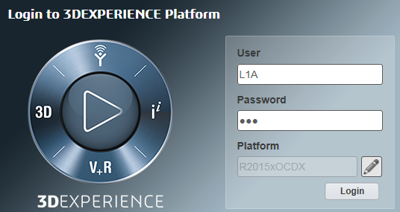
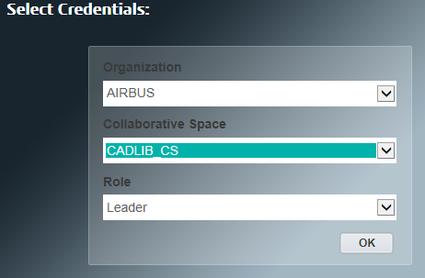
Security Context
A security context is an identification “string” that the user selects at login time.
It is composed of 3 parts:
Organization
Collaborative Space
Role
It is the unique information that dictates what the user can see and do during the life time of his session in the 3D Experience Platform.
Security Contexts are assigned by an Administrator.
The elements of the security contexts tag all data created during the user session.
Notes:
54

Slide 5
Organizations
Organizations reflects enterprise business decomposition and has an impact on data access.
Examples of usage:
ADS
Visibility on parent data*
ADS
Visibility on parent data*
AIT
MDO-TLS
MDO-TLS
SUPPLIER1
SUPPLIER2
SUPPLIER1
SUPPLIER2
No visibility trans organization if no security context
No visibility trans supplier until delivered if no security context
* Visibility is also dictated by Collaborative Spaces behaviors (next slides)
Notes:
54

Slide 6
Organizations Declaration
ADS
Business Units
PTH
TLS
STV
FDH
SUP1
SUP2
Companies
Notes:
54

Slide 7
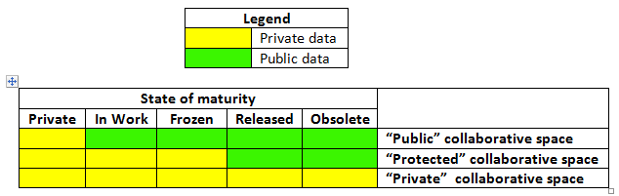
Collaborative Spaces
Containers (flat topology) to which all created data belong to in function of the login context of the creation user.
Used to segregate data and control access.
Collaborative Space Access
PRI
PRO
PUB
Current working hypotheses
Collab Space 1
Collab Space 2
Data Visibility from all users of the same Organization (or parent organization)
Notes:
54

Slide 8
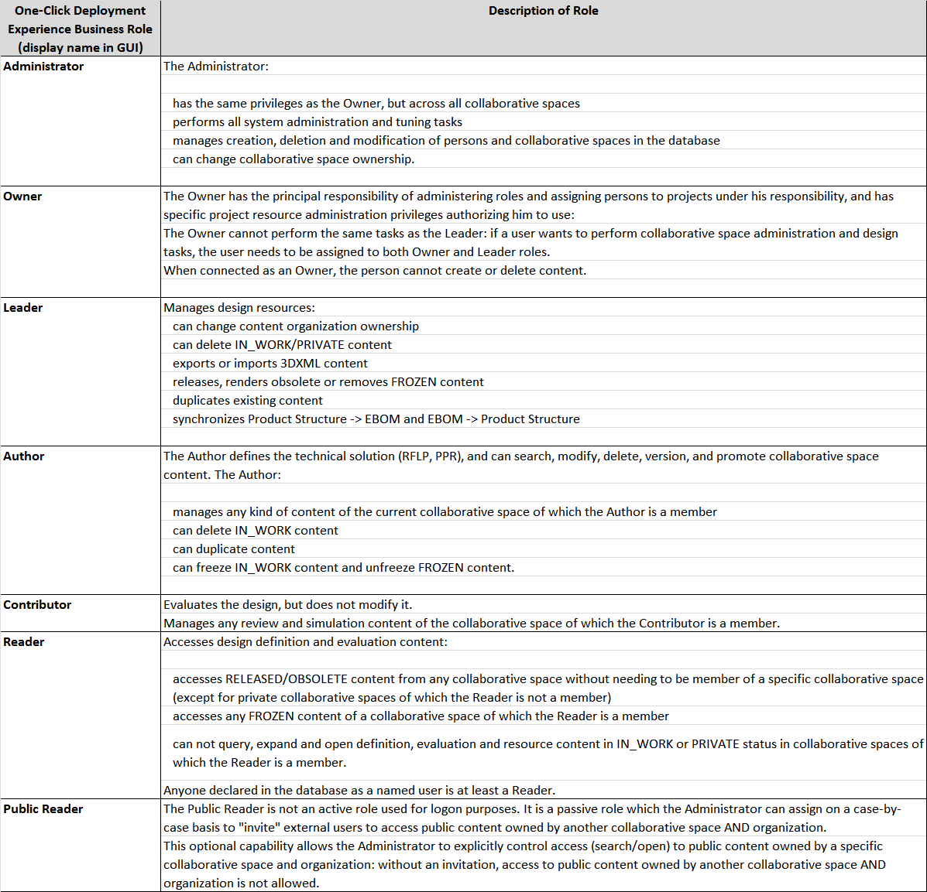
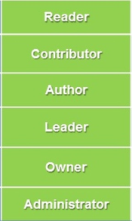
Roles
Manage the extent of the rights on data once logged into an organization and a coolaborative space
Notes:
54

Slide 9
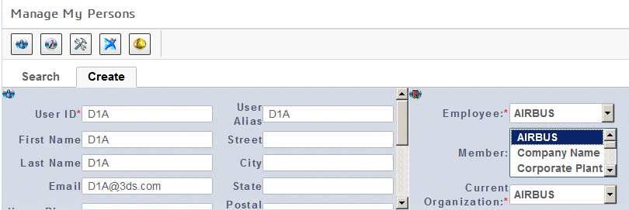
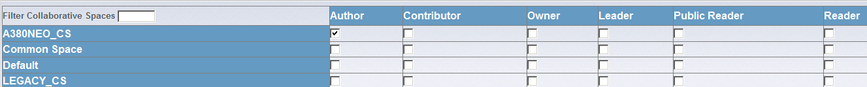
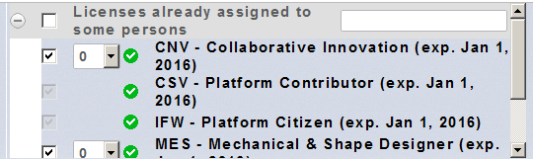
Users
Declaration through Administration interface by a dedicated Business Administrator
Management of user creation & information
Roles assignment
License assignment
Notes:
54

Slide 10
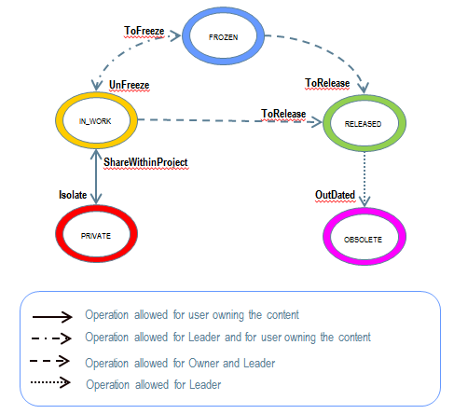
Life cycle
Decision needed on states & transitions removal and Names.
Notes:
54

Slide 11
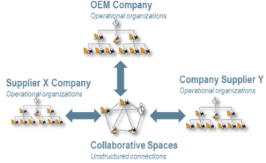
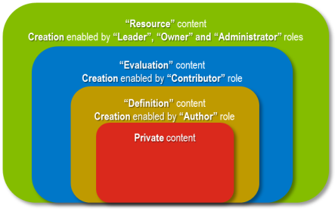

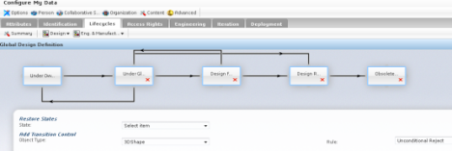
3D Experience “One-Click” Fundamentals
Main Principles
Business Roles
Collaborative Spaces & Organizations
Administration: Collaborative Deployment
Collaborative Spaces with “Public, Protected, Private” access
Organizations ascendant access for publish/promote business processes
Pre-defined set of roles enabling consistent and fast deployment
Content: Consistent Collaboration between 3DS apps
Streamlined behaviors thanks to classification of data to implement collaborative processes
Pre-defined life cycle maturity states for consistent collaboration of content
Read / Write security access vs. Roles
Configurable behaviors:
Configuring Content Security Read / Write access
Configuring Business Processes (e.g. Life Cycle, Naming)
Notes:
54

Slide 12
P&O updates impacts
Organization:
Rename (organization name is updated)
No impact on existing data, no migration needed
Be carefull login credential might has been stored (login tickets, etc…)
Ex: 3DIndex store its credentials so if the security context used for 3DIndex is impacted by the organization renaming then the 3DIndex environement has to be updated
Re-organization (Change parent)
No impact on existing data, no migration needed
Be carrefull, the visibility of the data could be updated accordingly to the no organization
Collaborative space
Rename collaborative space
No impact on existing data, no migration needed
Collab space cannot be deleted
Remove all security context allow to « hide » it to users
Be carrefull even without security context users might be able to see data

Slide 13
P&O OneClick in Practice for ADS

Slide 14
CS family & Linking rules
Standard CS data can only use (as a child) data from Standard CS
Private, Protected, Public CS can use data coming from any CS family including Standard (no linking rule)
Standard CS
Private CS
Private CS
Public CS
Father
Child
Authorized link
Father
Child
Forbidden link

Slide 15
Visibility in practice
Collaborative Space / Organisation / Cummulated CTX

Slide 16
Company
Organizations
Department
ADS
MDO_TLS
MDO_STV
MDO_FDH
MDO_PTH

Slide 17
Reference data set
Organizations
ADS
MDO_STV
MDO_TLS
Pri
SAT1_CS
1STV
1TLS
Pri
SAT2_CS
2STV
2TLS
Collaborative Spaces
Pub
STANDARD_CS
SSTV
STLS
Std
COMP_CS
CADS
Notes:
54

Slide 18
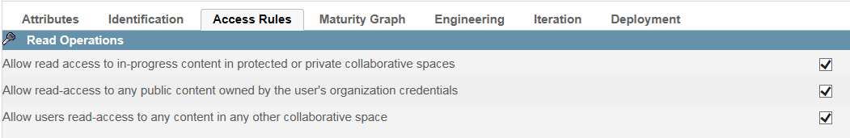
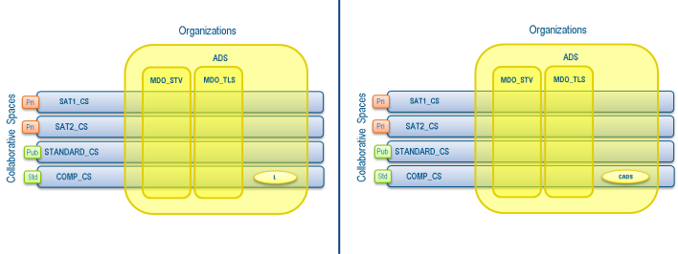
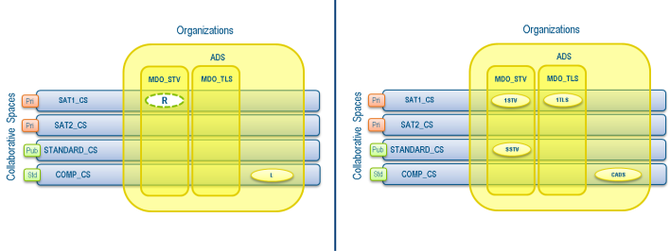


Scenario 1a
User CTX
What he sees
Active CTX is Leader in COMP on behalf of ADS
SSTV is seen because it is a public data in the same org as the passive CTX (reader on SAT1_CS on MDO_STV)
1TLS is seen because it is a public data of the CS as the passive CTX (reader on SAT1_CS on MDO_STV)
All data from the active CTX are visible to the user (except Under Owner Design & Public Reader)
1STV & 2STV are seen beacause of passive CTX
SSTV is seen because it is a public data in the same org as the passive CTX (reader on SAT1_CS on MDO_STV)
1TLS is seen because it is a public data of the CS as the passive CTX (reader on SAT1_CS on MDO_STV)
2TLS is seen because it is a public data of the CS as the passive CTX (reader on SAT2_CS on MDO_STV)
1STV & 1TLS are seen beacause of passive CTX
SSTV is seen because it is a public data in the same org as the passive CTX (reader on SAT1_CS on MDO_STV)
STLS is seen because it is a public data in the same org as the passive CTX (reader on SAT1_CS on MDO_TLS)
Notes:
54

Slide 19



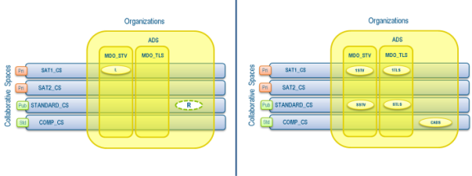

Scenario 1b
User CTX
What he sees
Active CTX is Leader in SAT1_CS on behalf of MDO_STV
SSTV is seen because it is a public data in the same org as the active CTX
CADS is seen because it is a public data in a father org (inherited) of the active CTX (MDO_STV is a department of ADS )
1TLS is seen because it is a public data in the same CS as the active CTX
CADS is seen because it is a public data in a father org (inherited) of the active CTX (MDO_STV is a department of ADS )
1TLS is seen because it is a public data in the same CS as the active CTX
Sxxx is seen because of passive CTX (reader on STANDARD on MDO_yyy)
Syyy is seen because it is a public data of the CS as the passive CTX (reader on STANDARD on MDO_xxx)
All data from the active CTX are visible to the user (except Under Owner Design & Public Reader)
Same result as above but using inheritance mechanism.
SSTV is seen because it is a public data in the same org as the active CTX
CADS is seen because it is a public data in a father org (inherited) of the active CTX (MDO_STV is a department of ADS )
1TLS is seen because it is a public data in the same CS as the active CTX
2STV is seen because of passive CTX (reader on SAT2 on MDO_STV
2TLS is seen because it is a data in the same CS as the passive CTX
Notes:
54

Slide 20


Scenario 1c
User CTX
What he sees
Active CTX is Leader in STANDARD_CS on behalf of MDO_STV
CADS is seen because it is a public data in a father org (inherited) of the active CTX (MDO_STV is a department of ADS )
STLS is seen because it is a public data in the same CS as the active CTX
All data from the active CTX are visible to the user (except Under Owner Design & Public Reader)
Same as Scenario 1b (2&3), only authoring rights change
Notes:
54

Slide 21
Summary
Active CTX gives access to:
All data of the CS (cross org)
All public data of the org (cross CS)
All public data of parent org (cross CS)
Passive CTX gives access to:
All data of the CS (cross org)
All public data of the org (cross CS)
All public data of parent org (cross CS)
Notes:
54

Slide 22
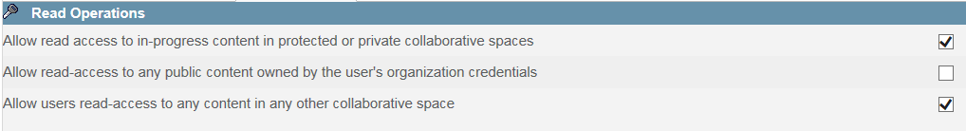

Scenario 2a
User CTX
What he sees
Active CTX is Leader in COMP on behalf of ADS
1STV is seen beacause of passive CTX
1TLS is seen because it is a public data of the CS as the passive CTX (reader on SAT1_CS on MDO_STV)
All data from the active CTX are visible to the user (except Under Owner Design & Public Reader)
Notes:
54

Slide 23




Scenario 2b
User CTX
What he sees
Active CTX is Leader in SAT1_CS on behalf of MDO_STV
1TLS is seen because it is a public data in the same CS as the active CTX
1TLS is seen because it is a public data in the same CS as the active CTX
Sxxx is seen because of passive CTX (reader on STANDARD on MDO_yyy)
Syyy is seen because it is a public data of the CS as the passive CTX (reader on STANDARD on MDO_xxx)
All data from the active CTX are visible to the user (except Under Owner Design & Public Reader)
Same result as above but using inheritance mechanism.
Notes:
54

Slide 24
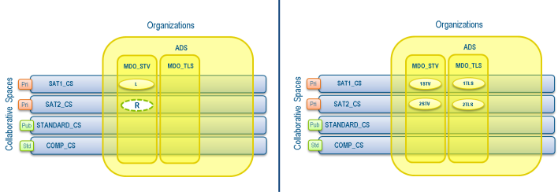
Scenario 2b
User CTX
What he sees
Active CTX is Leader in SAT1_CS on behalf of MDO_STV
1TLS is seen because it is a public data in the same CS as the active CTX
2STV is seen because of passive CTX (reader on SAT2 on MDO_STV
2TLS is seen because it is a data in the same CS as the passive CTX
All data from the active CTX are visible to the user (except Under Owner Design & Public Reader)
Notes:
54

Slide 25


Scenario 2c
User CTX
What he sees
Active CTX is Leader in STANDARD_CS on behalf of MDO_STV
STLS is seen because it is a public data in the same CS as the active CTX
All data from the active CTX are visible to the user (except Under Owner Design & Public Reader)
Same as Scenario 1b (2&3), only authoring rights change
Notes:
54

Slide 26
Summary
Active CTX gives access to:
All data in the CS (cross org)
Passive CTX gives access to:
All data in the CS (cross org)
Notes:
54

Slide 27
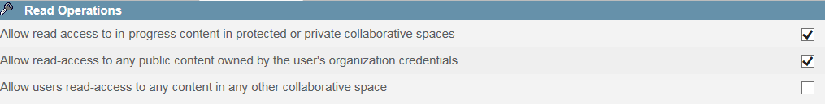



Scenario 3a
User CTX
What he sees
Active CTX is Leader in COMP on behalf of ADS
SSTV is seen because it is a public data in the same org as the passive CTX (reader on SAT1_CS on MDO_STV)
Note: Evenif a passive CTX is given on SAT1 no data can be seen as soon as those are private
All data from the active CTX are visible to the user (except Under Owner Design & Public Reader)
SSTV is seen because of passive CTX
Note: No STD seen as soon as no STD belong to ADS org
Notes:
54

Slide 28




Scenario 3b
User CTX
What he sees
Active CTX is Leader in SAT1_CS on behalf of MDO_STV
SSTV is seen because it is a public data in the same org as the active CTX
CADS is seen because it is a public data in a father org (inherited) of the active CTX (MDO_STV is a department of ADS )
1TLS is seen because it is a public data in the same CS as the active CTX
All data from the active CTX are visible to the user (except Under Owner Design & Public Reader)
Same result as above: passive ctx are useless
SSTV is seen because it is a public data in the same org as the active CTX
CADS is seen because it is a public data in a father org (inherited) of the active CTX (MDO_STV is a department of ADS )
1TLS is seen because it is a public data in the same CS as the active CTX
SSTV is seen because of passive CTX
Notes:
54

Slide 29

Scenario 3b
User CTX
What he sees
Active CTX is Leader in SAT1_CS on behalf of MDO_STV
SSTV is seen because it is a public data in the same org as the active CTX
CADS is seen because it is a public data in a father org (inherited) of the active CTX (MDO_STV is a department of ADS )
1TLS is seen because it is a data in the same CS as the active CTX
Note: Passive CTX is useless as soon as SAT2_CS is a pirvate CS
All data from the active CTX are visible to the user (except Under Owner Design & Public Reader)
Notes:
54

Slide 30


Scenario 3c
User CTX
What he sees
Active CTX is Leader in STANDARD_CS on behalf of MDO_STV
STLS is seen because it is a public data in the same CS as the active CTX
CADS is seen because it is a public data in a father org (inherited) of the active CTX (MDO_STV is a department of ADS )
All data from the active CTX are visible to the user (except Under Owner Design & Public Reader)
Same result as above: passive ctx are useless as soon as SAT1_CS is private
Notes:
54

Slide 31
Summary
Active CTX gives access to:
All data in the CS (cross org)
All public data of the org (cross CS)
All public data of parent org (cross CS)
Passive CTX gives access to:
All data belonging the org in the CS
All public data of the org (cross CS)
Notes:
54

Slide 32
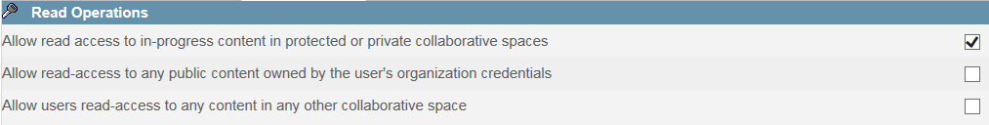


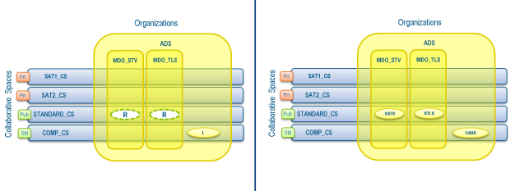
Scenario 4a
User CTX
What he sees
Active CTX is Leader in COMP on behalf of ADS
Same result as above: passive ctx are useless as soon as SAT1_CS is private
All data from the active CTX are visible to the user (except Under Owner Design & Public Reader)
SSTV is seen because of passive CTX on a public CS
Note: No STD seen as soon as no STD belong to ADS org
SSTV is seen because of passive CTX on a public CS
STLS is seen because of passive CTX on a public CS
Notes:
54

Slide 33




Scenario 4b
User CTX
What he sees
Active CTX is Leader in SAT1_CS on behalf of MDO_STV
1TLS is seen because it is a data in the same CS as the active CTX
Same result as above: passive ctx is useless as soon as no STD belongs to ADS org
All data from the active CTX are visible to the user (except Under Owner Design & Public Reader)
1TLS is seen because it is a data in the same CS as the active CTX
SSTV is seen because of passive CTX on a public CS
1TLS is seen because it is a data in the same CS as the active CTX
SSTV is seen because of passive CTX on a public CS on the org the data belongs to
STLS is seen because of passive CTX on a public CS on the org the data belongs to
CADS is seen because of passive CTX on a public CS on the org the data belongs to
Notes:
54

Slide 34

Scenario 4b
User CTX
What he sees
Active CTX is Leader in SAT1_CS on behalf of MDO_STV
1TLS is seen because it is a data in the same CS as the active CTX
Note: Passive CTX is useless as soon as SAT2_CS is a private CS
All data from the active CTX are visible to the user (except Under Owner Design & Public Reader)
Notes:
54

Slide 35



Scenario 4c
User CTX
What he sees
Active CTX is Leader in STANDARD_CS on behalf of MDO_STV
STLS is seen because it is a data in the same CS as the active CTX
STLS is seen because it is a data in the same CS as the active CTX
CADS is seen because of passive CTX on a public CS on the org the data belongs to
All data from the active CTX are visible to the user (except Under Owner Design & Public Reader)
Same result as above: passive ctx is useless as soon as SAT1_CS is private
Notes:
54

Slide 36
Summary
Active CTX gives access to:
All data in the CS (cross org)
Passive CTX gives access to:
All data belonging the org in the CS
Notes:
<numéro>

Slide 37
Visibility in practice
Maturity of the data

Slide 38
Reference data set
Organizations
ADS
MDO_STV
MDO_TLS
Pri
SAT1_CS
1STV
1TLS
1STV
1TLS
Pri
SAT2_CS
2STV
2TLS
Collaborative Spaces
2STV
2TLS
Pub
STANDARD_CS
SSTV
STLS
Std
COMP_CS
CADS
Notes:
<numéro>

Slide 39
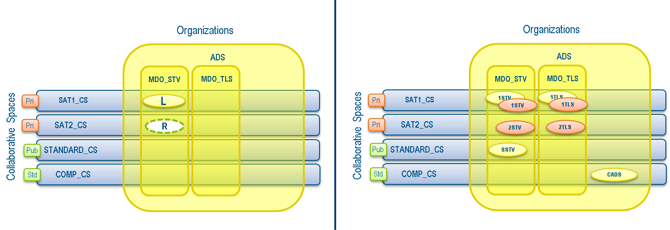

Scenario Maturity filter
User CTX
What he sees
Filter applied either on Active or Passive CTX
Filter act ONLY on Reader, Author & Contributor role
Active CTX is Leader in SAT1_CS on behalf of MDO_STV
All data from the active CTX are visible to the user (except Under Owner Design & Public Reader)
Active CTX is Reader in SAT1_CS on behalf of MDO_STV
Notes:
<numéro>

Slide 40
Editability in practice
Security context enforcement

Slide 41
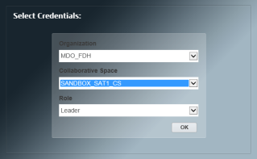
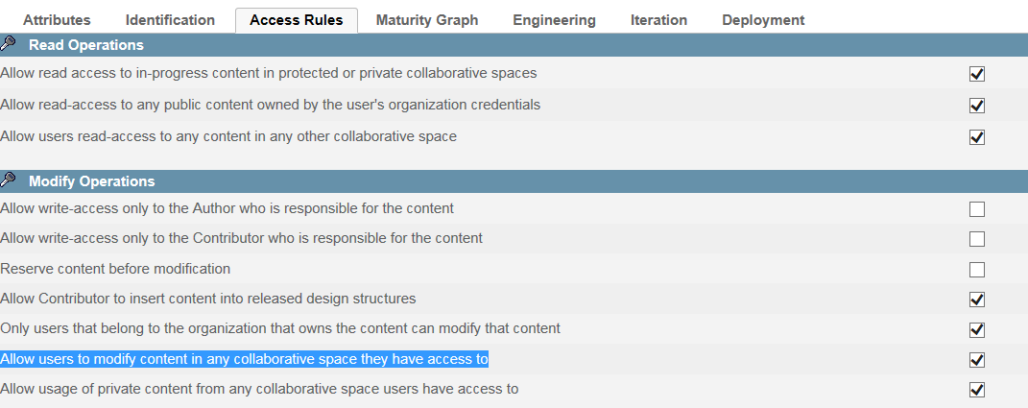
Choice 1a: TLS01 logged as Leader of MDO_TLS on SAT1_CS
Organizations
MDO_FDH
MDO_PTH
MDO_STV
MDO_TLS
ADS
Pri
SAT1_CS
R
R
R
L
SAT2_CS
R
Pri
Collaborative Spaces
STANDARD_CS
C
Pub
R
R
R
L*
COMP_CS
A
Std
R
L
O
L
Current login
L*
Cumulated Passive access right*: Reduced to modification rights of exiting data (change maturity, no version, …)
R
Cumulated access right: granted by additional ctx
R
Implicit access right: same CS or Children ORG
Notes:
<numéro>

Slide 42
Choice 1b: TLS01 logged as Leader of MDO_TLS on SAT1_CS
Organizations
MDO_FDH
MDO_PTH
MDO_STV
MDO_TLS
ADS
Pri
SAT1_CS
R
R
R
L
SAT2_CS
R
Pri
STANDARD_CS
C
Std
R
R
R
R
COMP_CS
A
Std
R
Collaborative Spaces
L
O
L
Current login
R
Cumulated Passive access right*
R
Cumulated access right: granted by additional ctx on other ORG
R
Implicit access right: same CS or Children ORG
Notes:
<numéro>

Slide 43
P&O OneClick in proposal for ADS

Slide 44
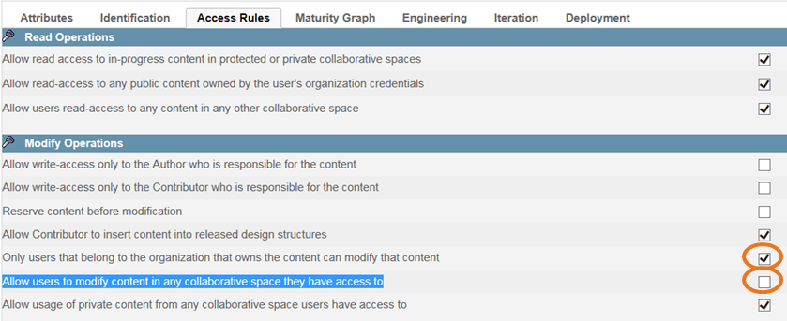
Editability
Double Security context enforcement
User has to be logged:
Same CS as the data
Same Org as the data
If the same user has Leader role in the same Org in 2 CS
Ex: Leader.MDO_TLS.STANDARDS & Leader.MDO_TLS.SAT1_CS
Switch between CS will be possible
Avoid modification errors when working with cumulative authoring ctx
Insure that the data is modified by a user from the same org

Slide 45
Visibility
User sees all data of the CS of the active ctx
User MUST have a passive ctx to see other data
Better control on which CS the user sees
No visibility control per organization
« user profiles » can be established
Administrators have to explicitly assign all necessary CTX

Slide 46
Collaborative Spaces
COMP_CS
standard
SAT1_CS
private
SAT2_CS
private
STANDARD_CS
Public

Slide 47
Linking rule summary
SAT1 use COMP = OK
COMP cannot use SAT1 or SAT2 or STANDARD = OK
STANDARD use COMP = OK
SAT1 use SAT2 = KO
STANDARD use SAT1 or SAT2 = KO
Status is valid on data that user sees

Slide 48
Users profiles
COMP designer/leader
Author or Leader in COMP_CS (standard public) in ADS org
STANDARD designer/leader
Author or Leader in STANDARD_CS (public) in MDO_xxx org
Reader in COMP_CS in ADS org
SAT designer/leader
Author or Leader in SATx_CS (private) in MDO_xxx org
Reader in STANDARD_CS in MDO_xxx org
Reader in COMP_CS in ADS org
COMP users will see only COMP, can edit only COMP
STD users will sees all STD and COMP, can edit only COMP of their org
SAT users will sees all STD and COMP, can edit only SAT data of their org

Slide 49
Users profiles
SAT viewer
Contributor or Reader in SATx_CS (private) in MDO_xxx org
Reader in COMP_CS in ADS org
DMU admin
Owner in SATx_CS (private) in ADS org
Author or Leader in STANDARD_CS (public) in ADS org
Reader in COMP_CS in ADS org
Can access or contribute to the SAT data (see DMU, etc…)
Nota: Impossible to switch between Owner & Leader role
Can administrates the resources of the CS (bind resources in Data Set Up)
Can create/ modify the resources of the CS (Rules, tables, etc…)

Slide 50
Cumulated profiles
Users might combine several profiles
Ex: SAT & COMP, SAT & STANDARD,…
Users with multiple SAT designer/leader profiles
Ex: SAT1 & SAT2
Visibility will not be impacted
Editability is secured as soon as the user must activate the ctx to be able to modify the data
Linking rules insured by Cs family
Linking rule: STD cannot use SAT is not insured
SAT users will sees all STD, COMP and SAT, can edit only SAT data of the active ctx
Linking rule: SATx cannot use SATy is not insured

Slide 51
Parametrization Management

Slide 52
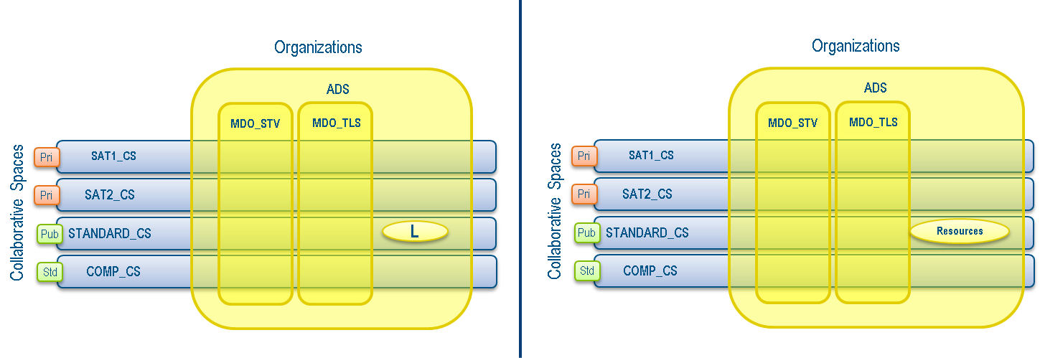
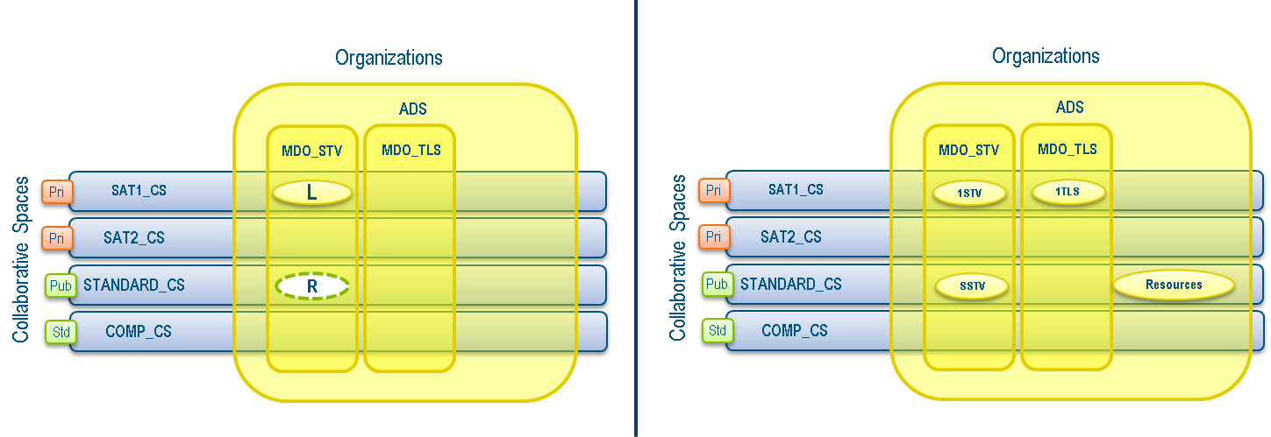
Parametrization definition
DMU Admin log as Leader in STANDARD_CS develops the application resources
Other users (Designer or Leader) can use the resources

Slide 53
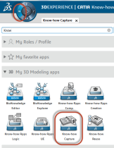
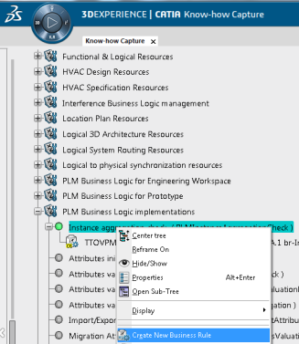
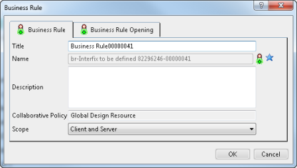
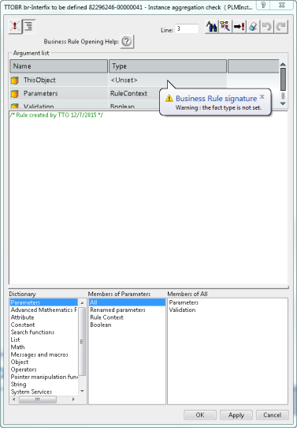
Parametrization implementation
DMU Admin logs as Leader in STANDARDS_CS on behalf of ADS
Launch the Know How Capture app
Requires a KHC license
Select the required Opening ID
Right click and select “Create New Business Rule”
Fill the creation panel
Finalize the creation
Implement the BL using the BL editor

Slide 54
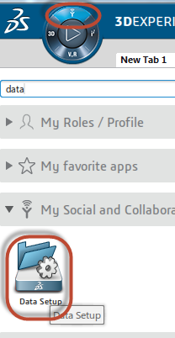
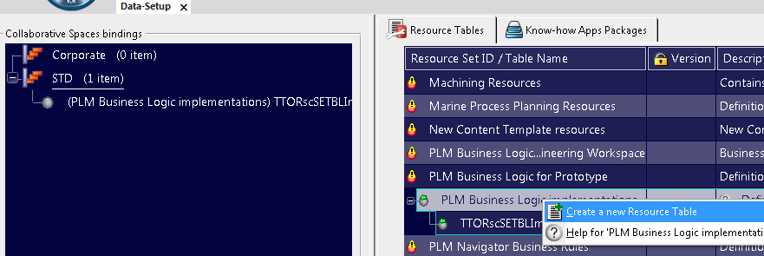
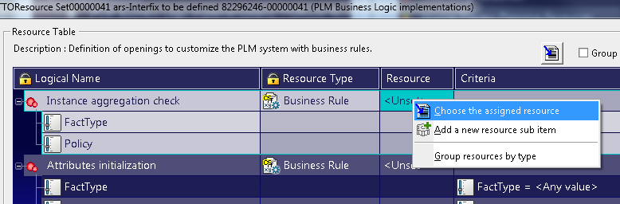
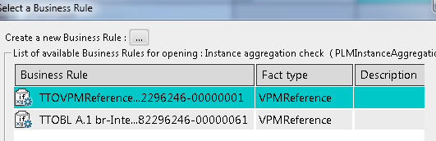
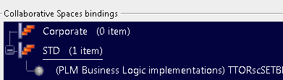
Parametrization deployment
DMU Admin logs as Owner in the relevant CS on behalf of ADS
Launch the Data Set Up app
Requires a MAN license
Select the required Resource Set ID
Right click and select “Create New Resource Table”
Fill the creation panel
Finalize the creation
Select the desired Logical Name
Choose the assigned re source in the list
Finalize the assignation
Bind (drag & drop) the resource in the CS

Slide 55
Parametrizations in practice

Slide 56
Linking rule for STD_CS
Rules:
Forbid usage of data from SATx_CS
Allow usage of COMP => Already done through CS family
Linking rule may be established by STD_CS Owner
Applicability of this rule will be restricted by Data Set Up to the CS it is bind to
No need to activate this rule to other CS than STD_CS
Applicability (scope) of the rule is controlled by Data Set up
More flexibility
Smaller scope leads to simplier BL

Slide 57
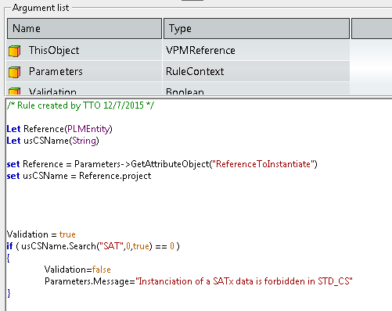
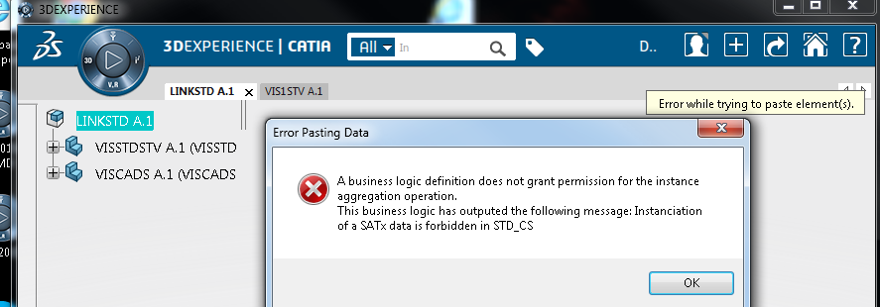
Linking rule sample
Rule output in not valid if the ReferenceToInstanciate belongs to a SATxxx CS
When log as Leader in STANDARD_CS if the user tries to instantiate a data coming from a SATxx_CS:
Instantiation is refused and an error message is raised
Nota: User must have a passive ctx on SATxx to be able to see the data

